Slide 1


Intro: Complexity VS. Simplicity
Computer System Principle (2025 Fall)
Yubin Xia, Xingda Wei
IPADS, Shanghai Jiao Tong University
https://www.sjtu.edu.cn

Slide 2
System: What & Why
What is system? Why should I learn how to think-in-system?

Slide 3
What does "System" Mean?
1: Software + hardware
Knowledge of OS, hardware, compiler, runtime, etc.
E.g., page table, TLB, file system
2: Way to think systematically
A way of analyzing and solving problems
E.g., system design principles
Notes:
什么是系统：
多个组件组成在一起。 比如敲了一行c++代码，是怎么在机器执行的？
系统化思维：
不能只考虑单点
Example: Incommensurate Scaling:
Mouth vs. Elephat
骨骼强度：n2
体积重量 n3

Slide 4
What is a System?
System =
Interacting set of components with a specified behavior at the interface with its environment
Examples
A web server, an Android phone, file systems, Linux, …

Slide 5
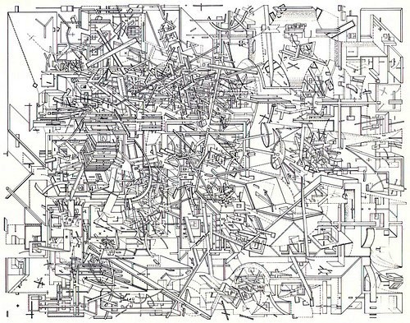
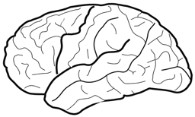
The Problem: Complexity of the Systems
Hard for human to fully understand
But, we can view from a system's perspective

Slide 6
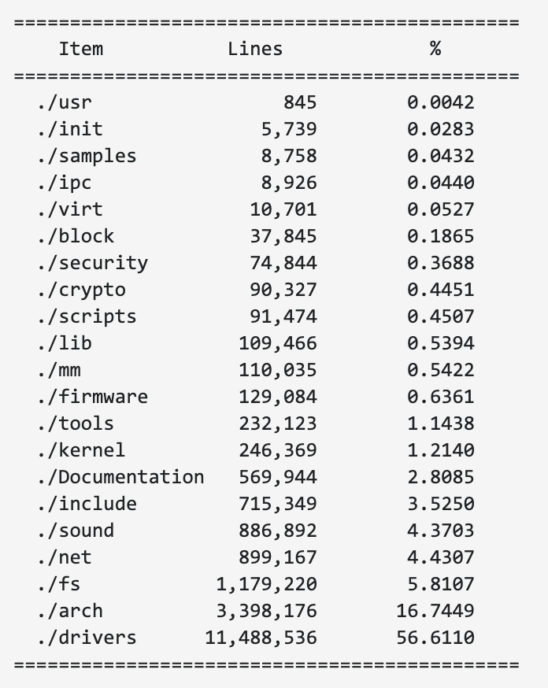
Example of Complex Systems: Linux Kernel
Notes:
More: http://www.informationisbeautiful.net/visualizations/million-lines-of-code/
https://unix.stackexchange.com/questions/223746/why-is-the-linux-kernel-15-million-lines-of-code

Slide 7
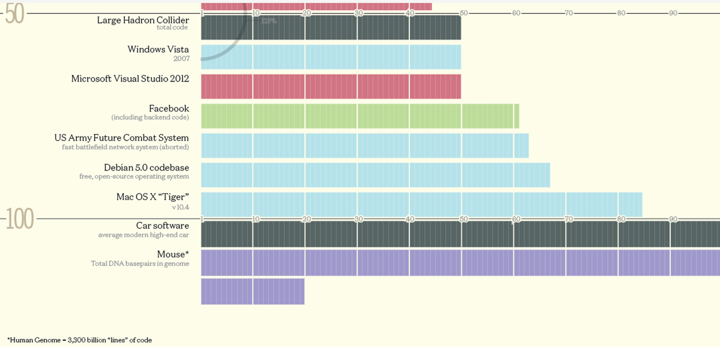
LoCs of Different Systems

Slide 8
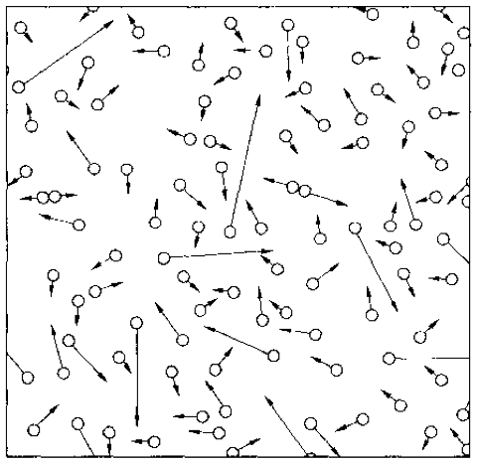
An Example: The Gas System
A systematical way to understand a complex system is needed
Notes:
system has properties that a node has not.
gas molecule properties: speed, a, m, size
gas system properties: pressure, temperature
Computer system properties: consistency, fault tolerance, performance,…

Slide 9
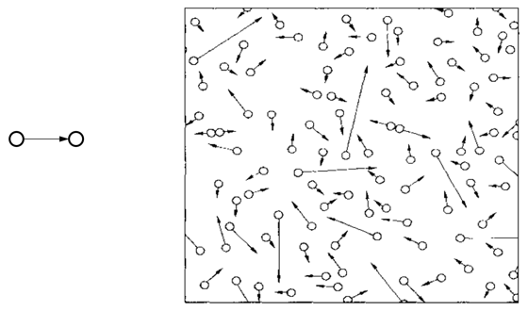
Compare with the Computer Systems
Programming / Data Structure
LoC (Lines of Code): From hundreds to millions
Operating System / Architecture
CPU cores: from one to hundreds
Network
Nodes: from two to millions
Web Service
Clients: from tens to millions
Notes:
Software Engineering:
Programmers: from one to thousands
More on people, not system

Slide 10
Why System?
For fun and profit

Slide 11
Reason-1: For Fun (Finding Problems)
Know a system by playing with it
The more you know about the system, the more likely to find interesting features (or, bugs with another name)

Slide 12
An Example: Guessing Password
checkpw (user, passwd):
acct = accounts[user]
for i in range(0, len(acct.pw)):
if acct.pw[i] ≠ passwd[i]:
return False
return True
passwd:
P
A
S
S
W
O
R
D
X
acct.pw:
P
A
S
S
w
O
R
D
Notes:
能否使用时间差，猜出这个密码？不使用暴力枚举
Assumption：acct.pw在内存里， passwd的位置可以由用户控制

Slide 13
Timing Attack: Guess One Character at a Time
Guess a password
Allocate password 1 byte away from a page boundary
Page-fault means first char is OK
Example of cross-layer interactions
Also known as “Timing Attack”
Notes:
1. 先讲virtual memory,ondemand paging 和page fault

Slide 14
Timing Attack: Guess One Character at a Time
Page in Memory
a
b
c
ca
…
cs
…
Page on Disk -> Page Fault
aaaaaaa
aaaaaaa
aaaaaaa
aaaaaa
aaaaaa
Time = 1ms
Time = 1ms
Time = 10ms
Time = 1ms
Time = 10ms
Page Fault!
The 1st char is ‘c’
Page Fault!
The 2nd char is ‘s’
Notes:
不知道底层问题的时候，就可能会出现问题。
需要专门的处理。

Slide 15

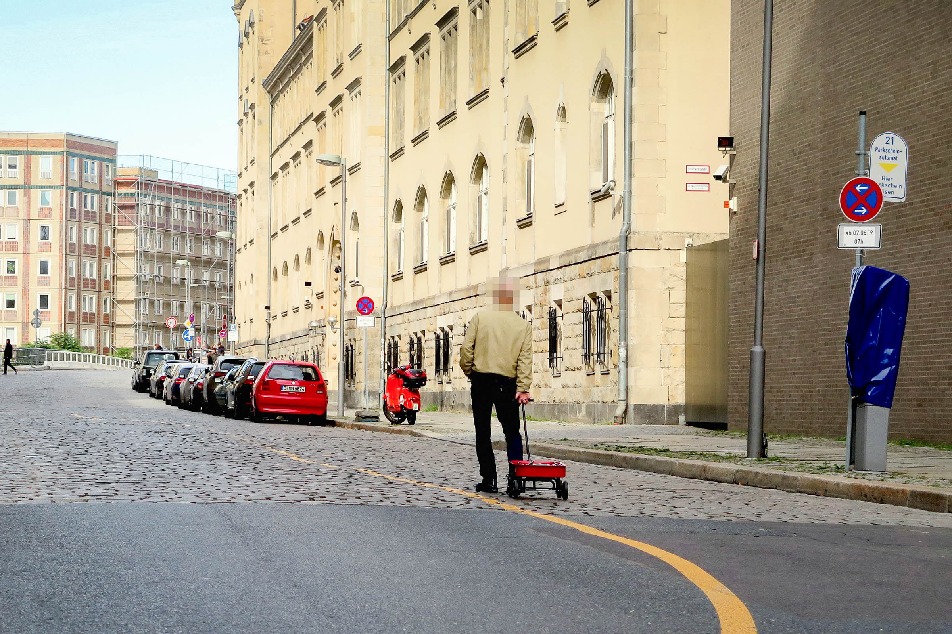
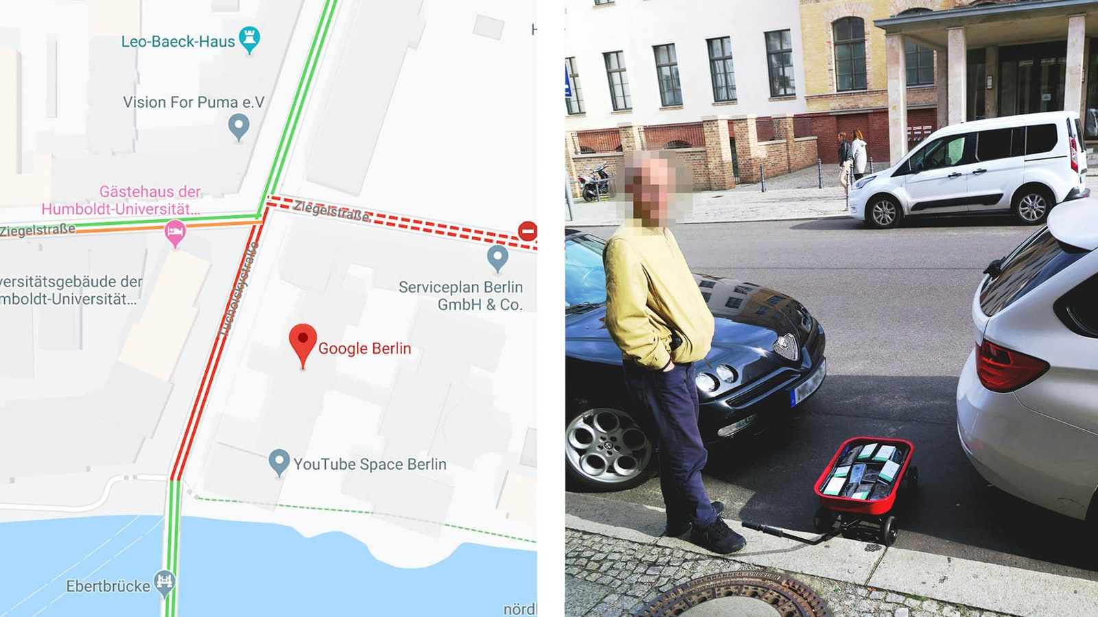
Notes:
手机app：detect jam
问题：怎么detect？

Slide 16
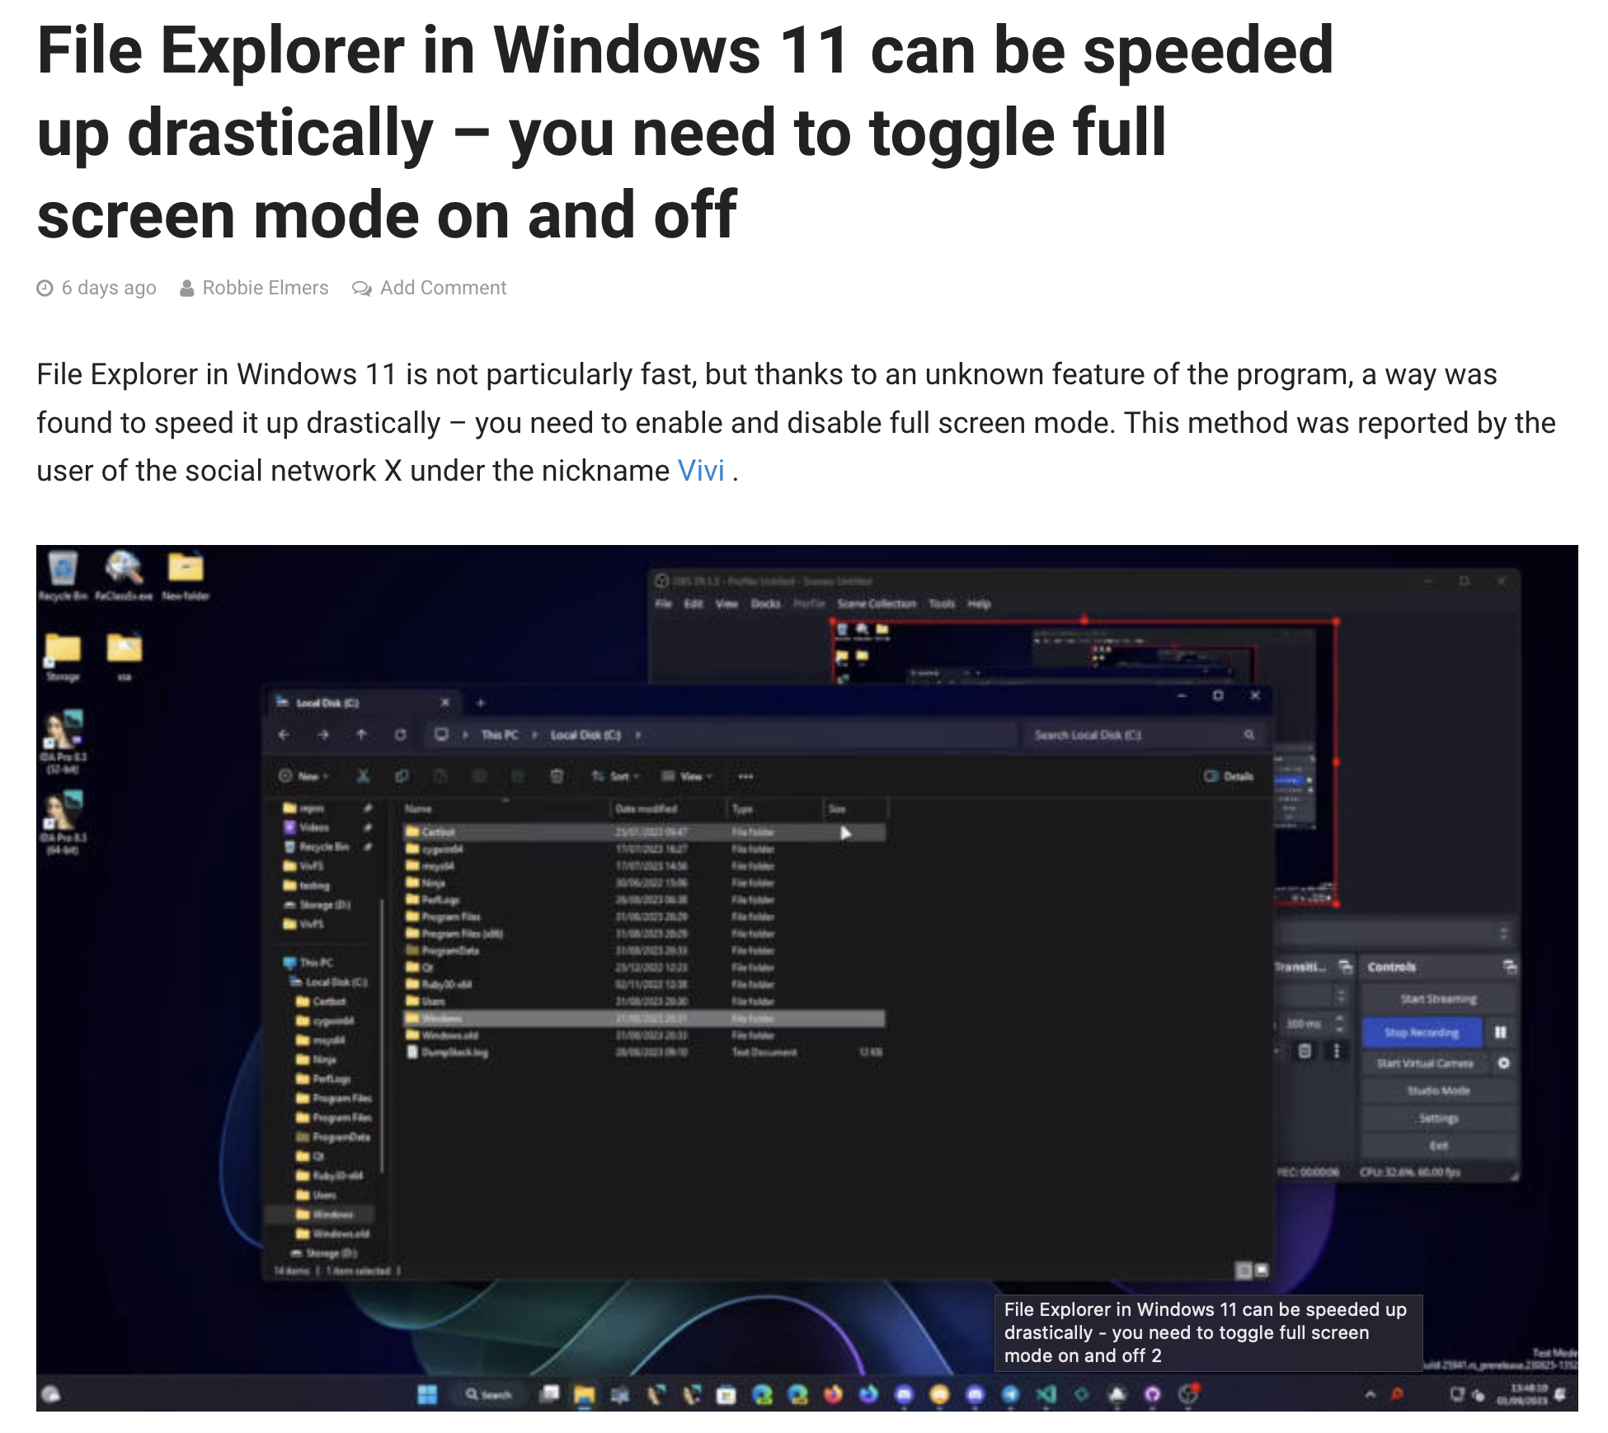

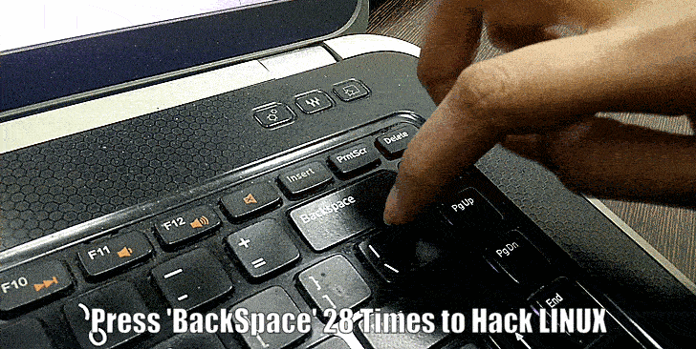
Windows双击F11加速？
Linux 28击退格键直接登录？
Notes:
F11:全屏
全屏会关闭很一些文件浏览的机制；导致加速

Slide 17
Reason-2: For Profit (To Solve Problems)
System is low-level, under other components
New features: migration, snapshot, replay, fault tolerant, etc.
Performance: hardware features, kernel primitives, system-level profiling, consistency model, etc.
Security: buffer overflow, ROP/JOP, side-channel, etc.
Chance to have a start-up

Slide 18
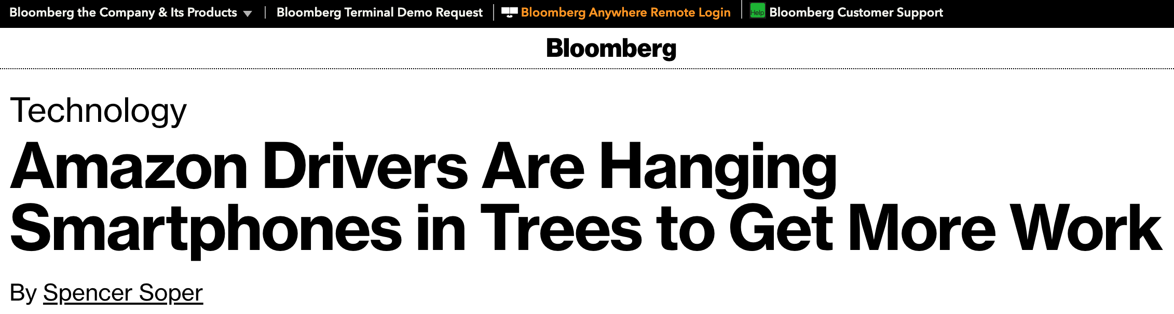

Someone places several devices in a tree located close to the station where deliveries originate. Drivers in on the plot then sync their own phones with the ones in the tree and wait nearby for an order pickup. The reason for the odd placement, according to experts and people with direct knowledge of Amazon’s operations, is to take advantage of the handsets’ proximity to the station, combined with software that constantly monitors Amazon’s dispatch network, to get a split-second jump on competing drivers.
Notes:
早期AWS怎么接单：通过找到最近的骑手接单。
网络是具有locality的，如🃏牌照，量化

Slide 19
14 Properties

Slide 20
14 Properties of Computer Systems
Correctness
Latency
Throughput
Scalability
Performance Isolation
Utilization
Energy Efficiency
Consistency
Fault Tolerance
Security
Privacy
Trust
Compatibility
Usability

Slide 21
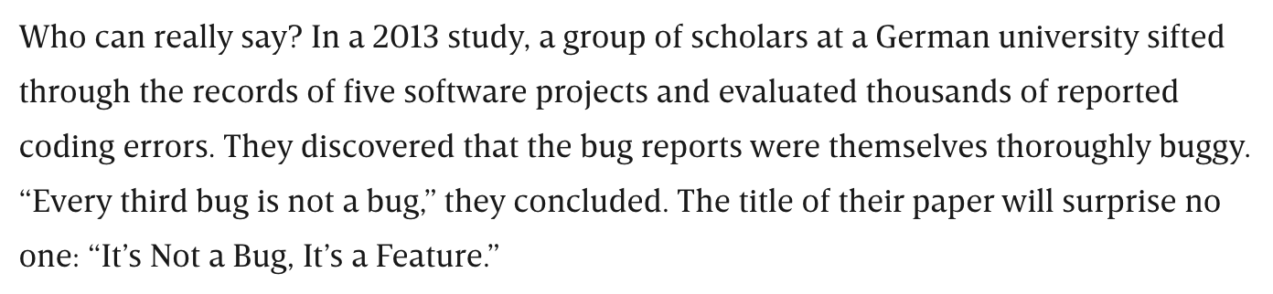
Property-1: Correctness
Seems straightforward
But correctness is hard to define
How to describe the functionalities of your code?
https://www.wired.com/story/its-not-a-bug-its-a-feature/

Slide 22
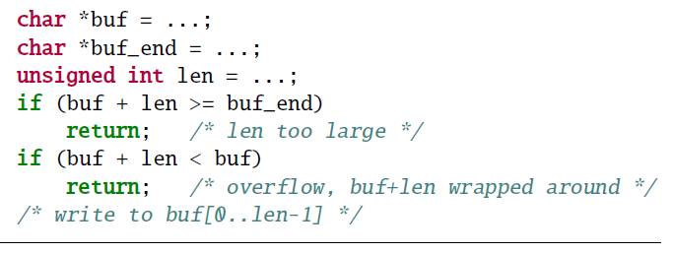
A Piece of Code, Seems Normal
Notes:
汇编没有包含这个代码：因为这是undefined behavir，gcc认为不会发生

Slide 23
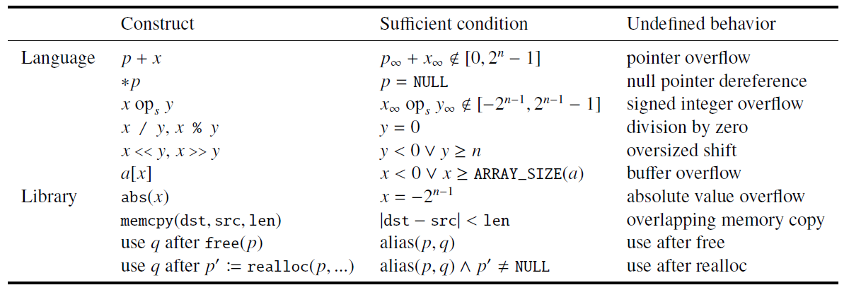
Undefined Behavior

Slide 24
Isn’t it a bug of compilers?
A story: GCC bug #30475 (2007/01/15)
A GCC user
"This will create MAJOR SECURITY ISSUES in ALL MANNER OF CODE. I don’t care if your language lawyers tell you gcc is right. . . . FIX THIS! NOW!"
A GCC developer
"I am not joking, the C standard explicitly says signed integer overflow is undefined behavior. . . . GCC is not going to change."
http://gcc.gnu.org/bugzilla/show_bug.cgi?id=30475

Slide 25
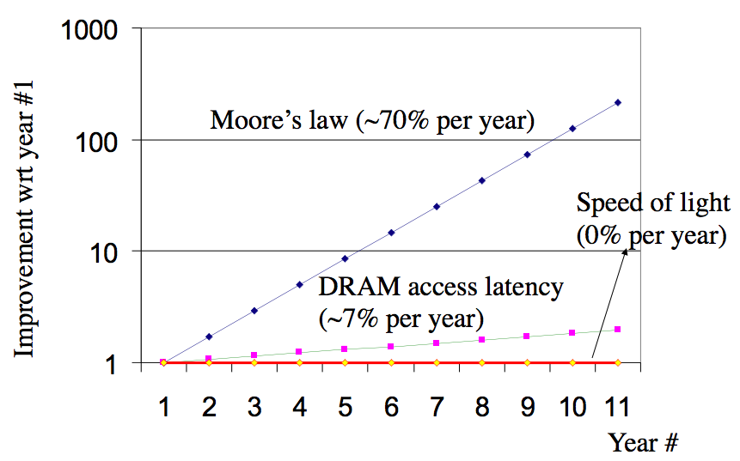
Property-2: Latency
How fast can your program run?
Latency is hard to optimize, it has physical limitations

Slide 26
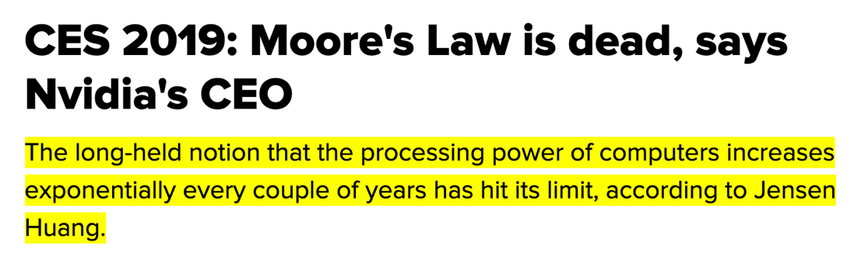
Property-3: Throughput
7nm → 5nm → 3nm → 2nm... what's next?
Once stop getting smaller, it has to go bigger

Slide 27
Property-4: Scalability
Ideal performance
Real
performance

Slide 28
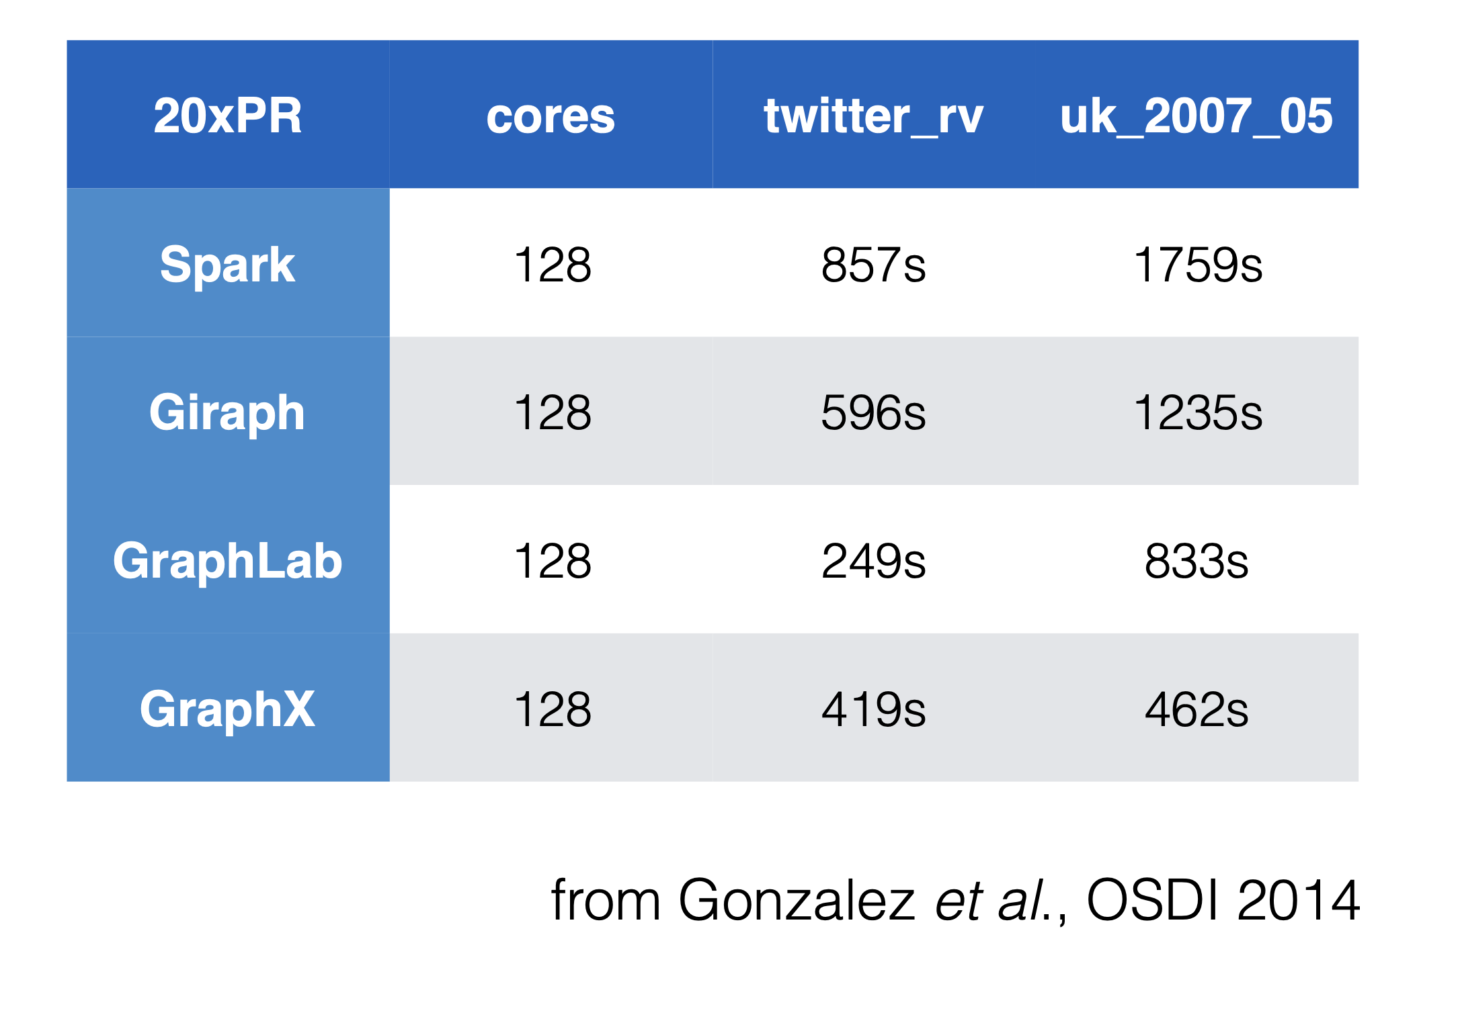
Question: is scale always good?

Slide 29
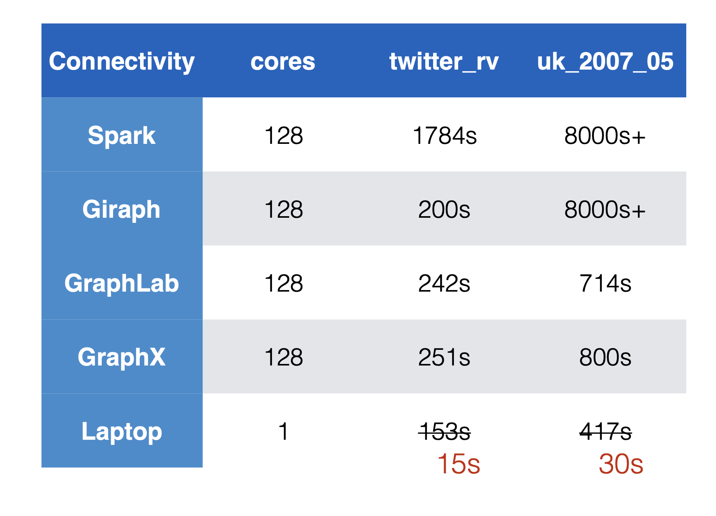

Slide 30
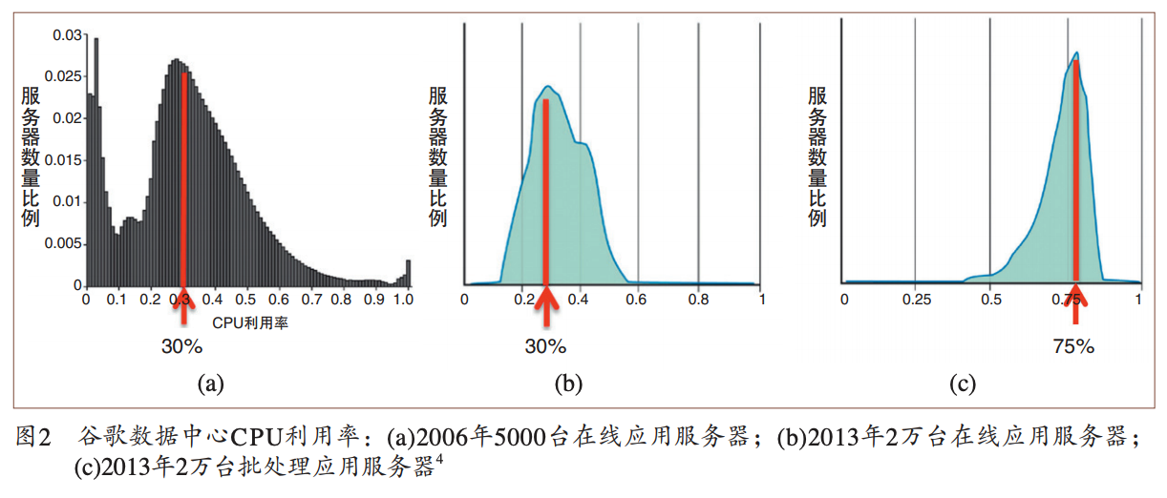
Property-5: Utilization
数据来源：“数据中心成本与利用率现状分析”, 中国计算机学会通讯，2015.

Slide 31
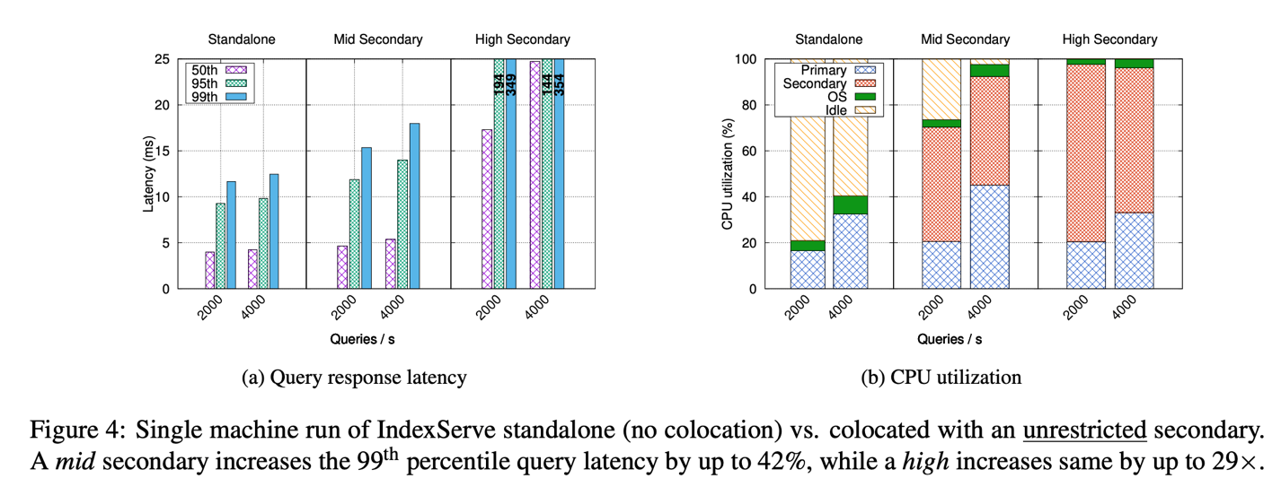
Property-6: Performance Isolation
Iorgulescu, Călin, et al. "Perfiso: Performance isolation for commercial latency-sensitive services." USENIX ATC'18.

Slide 32

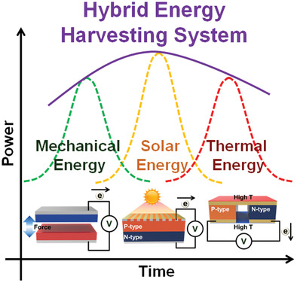

Property-7: Energy Efficiency
Notes:
“It is estimated that a single Google search could power a low-energy light bulb for an hour.” - https://fullfact.org/environment/google-search/

Slide 33
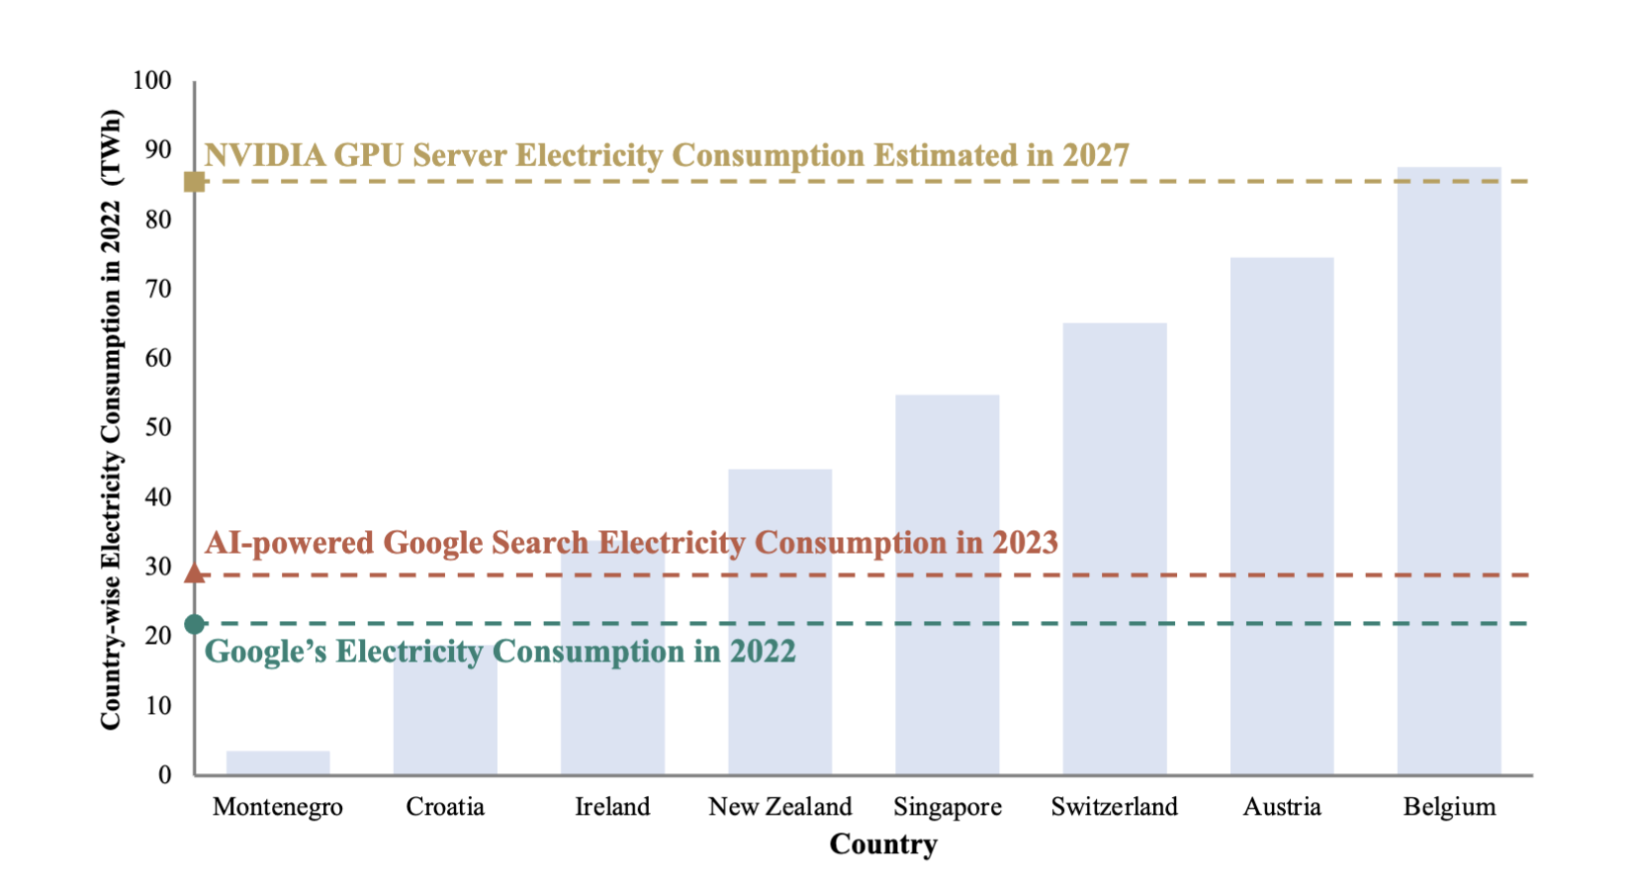
Property-7: Energy Efficiency
Notes:
山共和国（Montenegro）

Slide 34
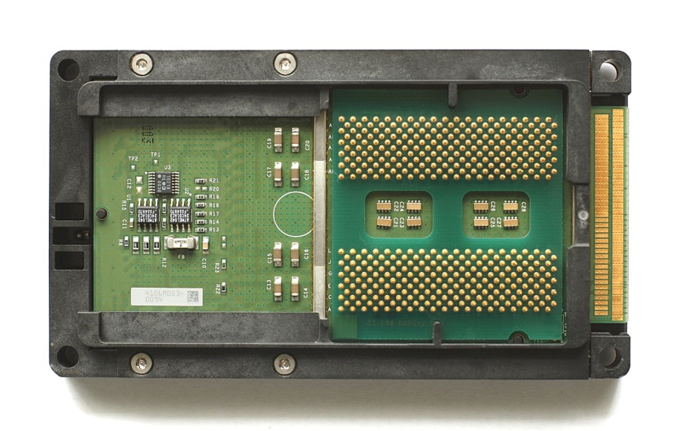
Property-8: Compatibility
Intel's Itanium, 64-bit, not compatible to x86, died.
Itanium Process, from Wikipedia
Notes:
成功的ISA：AMD-64
Tensorflow v1, v2

Slide 35
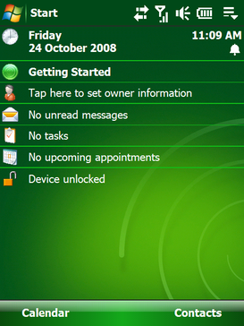
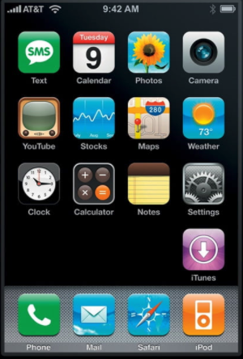
Property-9: Usability

Slide 36
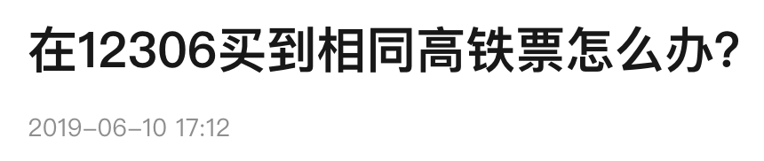
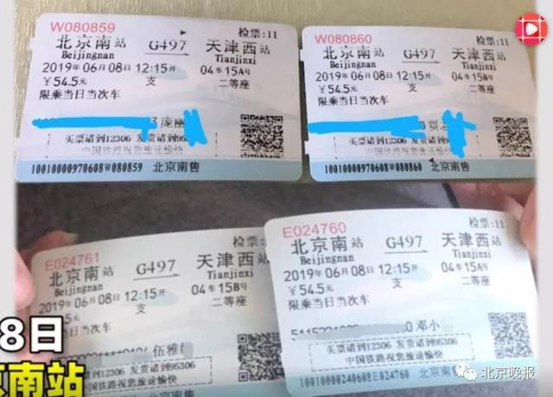
Property-10: Consistency
据时间视频消息，6月8日，北京南站，庞女士和丈夫乘坐G497列车，上车后发现票面上的座位坐了人。庞女士和在座位上的乘客交涉后，发现除了身份证和姓名不一样之外，她们的票和自己手上的票一模一样。两人均是在窗口购票，双方购票相差时间三分钟左右。双方在找到列车长之后，庞女士被安排到了另一个车厢。
针对此事，12306客服回应称这种情况很少见，可能是由于机器故障所致。

Slide 37
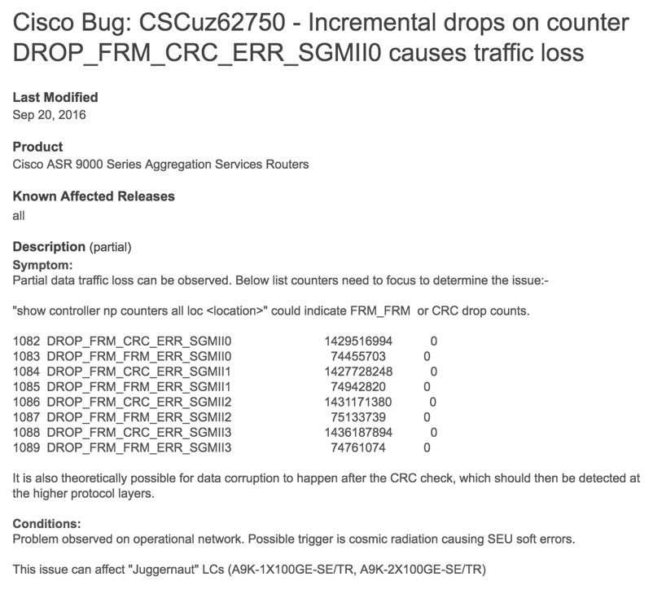
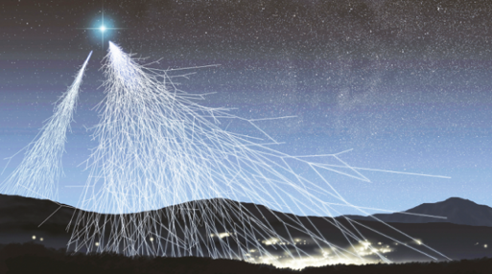
Property-11: Fault Tolerance
A bug of Cisco router is caused by cosmic radiation
Cosmic radiation
Notes:
例子：军事卫星

Slide 38


Property-11: Fault Tolerance
Row Buffer
Row 1
0
1
1
1
Row 2
Row 3
Row 4
Rowhammer Attack: flip memory bits!
Notes:
当你非常快速地重复访问一个内存行（称为“hammering”），这种行为可能会产生足够的电磁干扰，导致相邻内存行中的电荷发生变化。最终，这种干扰会导致存储在相邻行的某些比特（0 或 1）翻转，比如从 0 变成 1，或者从 1 变成 0。

Slide 39
Property-11: Fault Tolerance
Row Buffer
Row 1
0
1
1
1
Row 2
Row 3
Row 4
Rowhammer Attack: flip memory bits!

Slide 40
Property-11: Fault Tolerance
CPU Architecture | Errors | Access-Rate
Intel Haswell (2013) | 22.9K | 12.3M/sec
Intel Ivy Bridge (2012) | 20.7K | 11.7M/sec
Intel Sandy Bridge (2011) | 16.1K | 11.6M/sec
AMD Piledriver (2012) | 59 | 6.1M/sec
Row Buffer
Row 1
0
0
1
1
Row 2
Row 3
Row 4
Rowhammer Attack: flip memory bits!
Notes:
DDR-4可能缓解

Slide 41
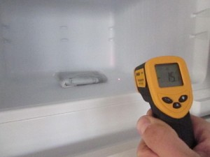
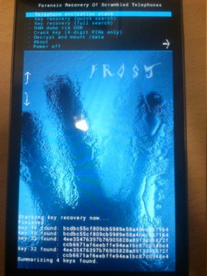
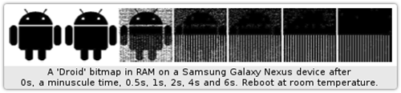
Property-12: Security
Cold-boot attack: physically attack that can scan memory to get any plaintext
Müller, Tilo, and Michael Spreitzenbarth. "Frost." Applied Cryptography and Network Security. Springer Berlin Heidelberg, 2013.
Notes:
Why we need cold boot? Because the device could be locked.
But its memory is not.
Mac OS X leaves the user’s lo- gin password in memory

Slide 42
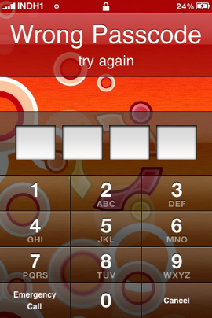
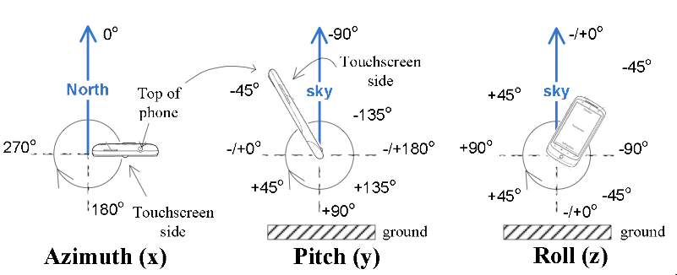
Property-12: Security
Side-Channel: infer PIN code through motion-detector
Cai, Liang, and Hao Chen. "TouchLogger: Inferring Keystrokes on Touch Screen from Smartphone motion." HotSec. 2011.

Slide 43
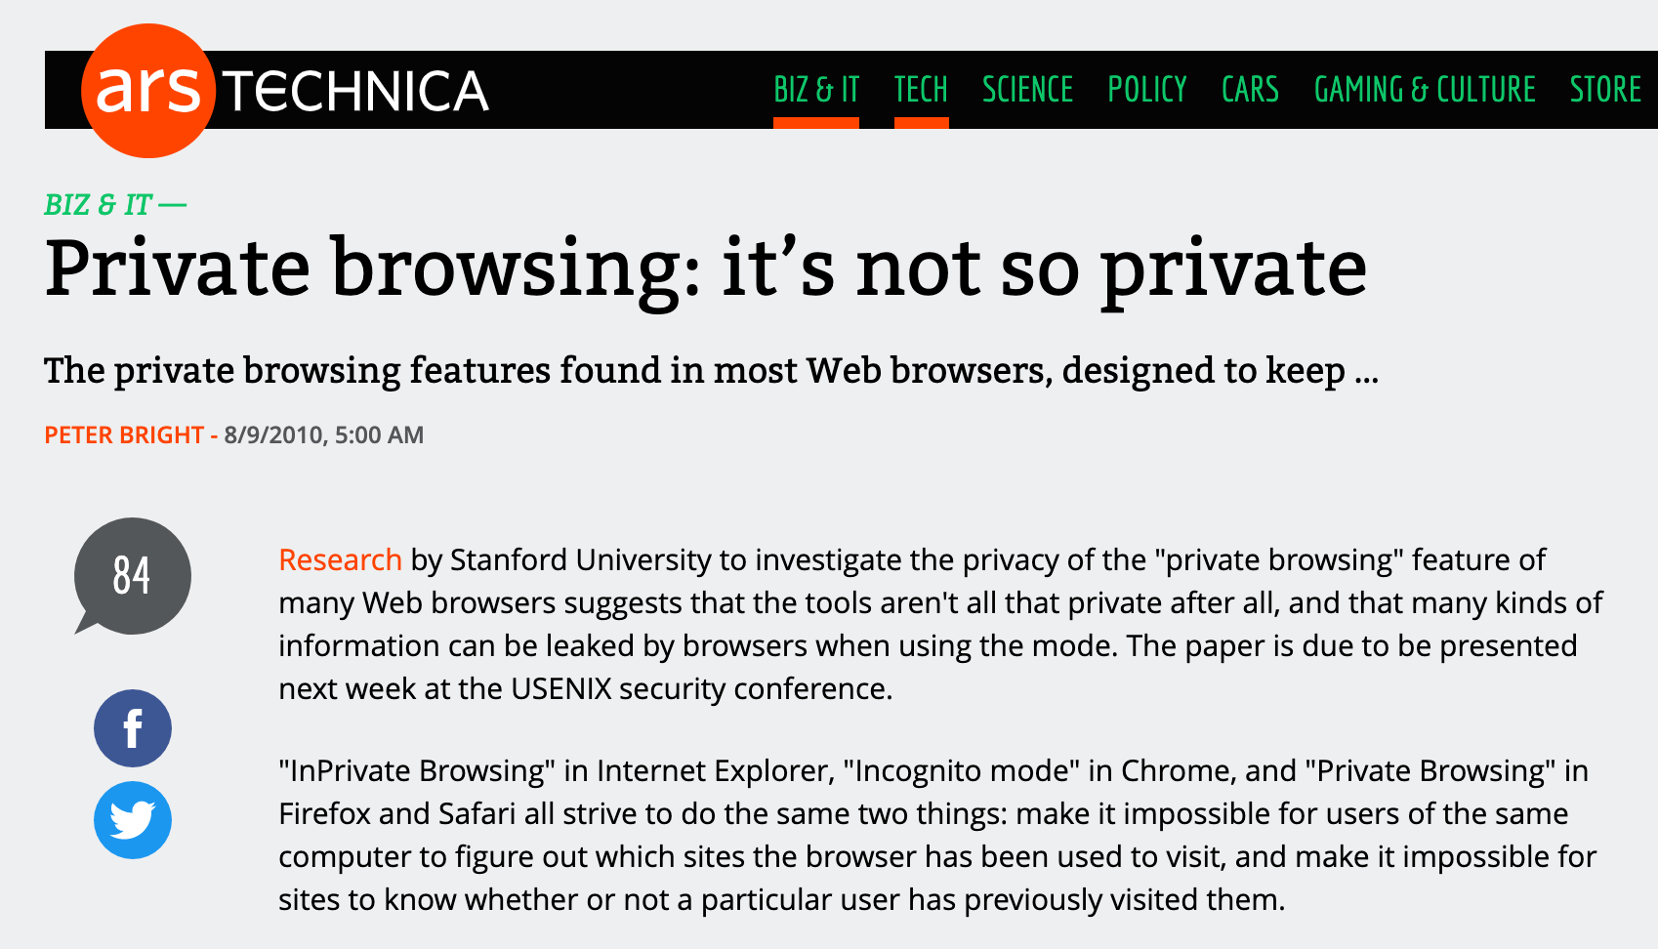
Property-13: Privacy
Notes:
Private vs. non-private setup

Slide 44

Property-14: Trust
Guess where is your money?
Fighting Club, 1999

Slide 45
Conflict between these Properties
Usability VS. Privacy
Performance VS. Security
Fault Tolerance VS. Consistency
Throughput vs. latency
...
All these lead to more complexity
Notes:
U vs. P: 每次都输入密码； 每次prompt都去网站
Performance vs. security: xxx
Fault vs. C: CAP 定理

Slide 46
The Principles

Slide 47
General Design Principles: 1/3
Adopt sweeping simplifications
Avoid excessive generality
Avoid rarely used components
Be explicit
Decouple modules with indirection
Design for iteration
Notes:
来自MIT的 frans
按照顺序排序
Be explicit: rust
Indirection: every computer problem can be addressed via an indirection

Slide 48
Keep simple, Keep stupid

Slide 49

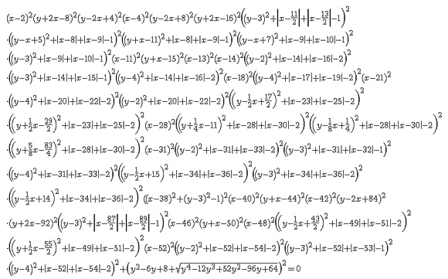
Occam's Razor
Aka., law of parsimony
Now, chose between following two equations:
E = mc²

Slide 50
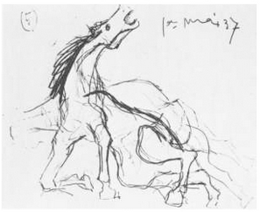
Horse, by Picasso

Slide 51
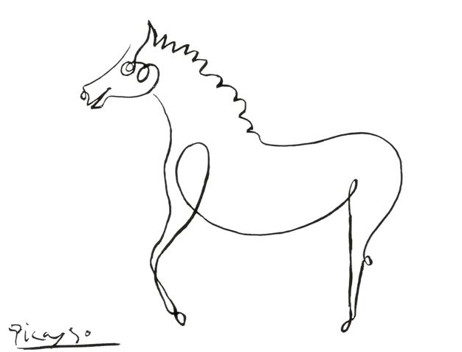
Another Horse, by Picasso

Slide 52

Yet Another Horse, by Picasso

Slide 53
CASE Study: Bash Attack
What does KISS cost?
Notes:
简单是有代价的

Slide 54
ShellShock Attack
Found by Stéphane Chazelas
CVE-2014-6271 & CVE-2014-7169

Slide 55
The Vulnerability
A function is defined in a var, which is exported
A child bash copies all of its parent’s env vars
The child will execute some code in a var during the copy!
$ export X='() { echo "inside X"; }; echo "outside X";'
$ bash
outside X
$ env
…
X=() { echo “inside X” }
…

Slide 56
The Vulnerability
env VAR='() { :;}; echo Bash is vulnerable!' bash -c "echo Bash Test”
‘:’ means ‘/bin/true’, which returns true and return
Now please explain this test by yourselves
What would be executed during bash forking?
What can an attacker do if she can define such VAR?
Notes:
Echo bash is vulnerable!

Slide 57
Why Big Deal?
On apache server, it is typical to fork a child process for each HTTP client
Use bash env variables a lot
A DHCP client may get malicious value from a malicious DHCP server
Notes:
https://securityblog.redhat.com/2014/09/24/bash-specially-crafted-environment-variables-code-injection-attack/

Slide 58
Why ShellShock Ever Exist?
Three principles of UNIX programming ^{[1]}:
Write programs that do one thing and do it well
Write programs to work together
Write programs to handle text streams, because that is a universal interface
[1] http://en.wikipedia.org/wiki/Unix_philosophy

Slide 59
More on Interesting Shell
$ ls -l *.c
“ls”, “-l”, "*.c” # *.c =>“foo.c” “bar.c”
“ls”, “-l”, “foo.c” “bar.c”
What if a file with name “-l”?
>-1
Notes:
You can use ‘rm ./-l’ to remove the file.

Slide 60
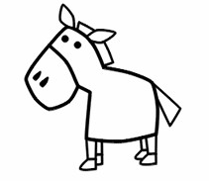
The Simpler, The Better?
No…
The point is: how to find a right way to be simple?

Slide 61
General Design Principles: 1/3
Adopt sweeping simplifications
Avoid excessive generality
Avoid rarely used components
Be explicit
Decouple modules with indirection
Design for iteration
Notes:
来自MIT的 frans
按照顺序排序
Be explicit: rust
Indirection: every computer problem can be addressed via an indirection

Slide 62
General Design Principles: 1/3
Adopt sweeping simplifications
Avoid excessive generality
Avoid rarely used components
Be explicit
Decouple modules with indirection
Design for iteration
Notes:
来自MIT的 frans
按照顺序排序
Be explicit: rust
Indirection: every computer problem can be addressed via an indirection

Slide 63
General Design Principles: 1/3
Adopt sweeping simplifications
Avoid excessive generality
Avoid rarely used components
Be explicit
Decouple modules with indirection
Design for iteration
Notes:
来自MIT的 frans
按照顺序排序
Be explicit: rust
Indirection: every computer problem can be addressed via an indirection

Slide 64
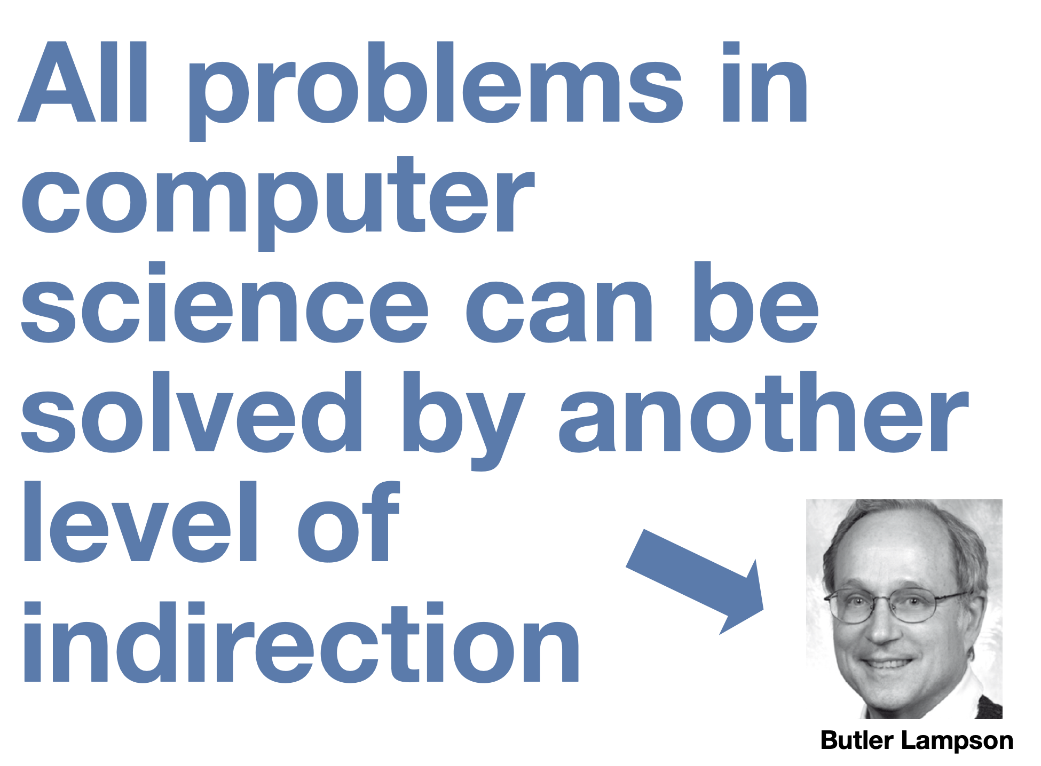
Notes:
that is attributed to David Wheeler

Slide 65
Indirection examples
Virtual memory
DNS
File system
Etc.

Slide 66
General Design Principles: 1/3
Adopt sweeping simplifications
Avoid excessive generality
Avoid rarely used components
Be explicit
Decouple modules with indirection
Design for iteration
Notes:
来自MIT的 frans
按照顺序排序
Be explicit: rust
Indirection: every computer problem can be addressed via an indirection

Slide 67
General Design Principles: 2/3
End-to-end argument
Escalating complexity principle
Incommensurate scaling rule
Keep digging principle
Law of diminishing returns
Open design principle
Notes:
解释下什么是end-to-end：和机器学习里面的不一样；以网络为例子，出错处理
Incommensurate scaling:
之前的老鼠例子
RDMA
Law of diminishing returns： 边际效应。阿姆达尔定律。

Slide 68
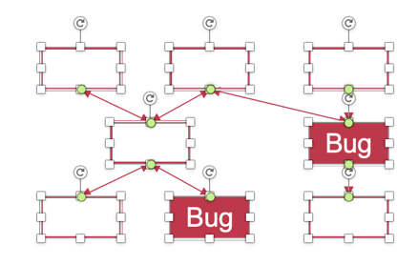
Example: Scaling Figures in PPT
Bug
Bug
Original
A mess after scaling

Slide 69
General Design Principles: 3/3
Principle of least astonishment
Robustness principle
Safety margin principle
Unyielding foundations rule
Notes:
Principle of least astonishment: 符合用户的预期； general design
Unyielding foundations rule: 怎么模块化，很重要；不要动模块

Slide 70
Specific Area Principles (1/2)
Atomicity: Golden rule of atomicity
Coordination: One-writer principle
Durability: The durability mantra
Security: Minimize secrets
Security: Complete mediation
Security: Fail-safe defaults

Slide 71
Specific Area Principles (2/2)
Security: Least privilege principle
Security: Economy of mechanism
Security: Minimize common mechanism

Slide 72
We will see more in future lectures

Slide 73
Design Hints
Exploit brute force
Instead of reducing latency, hide it
Optimize for the common case
Separate mechanism from policy

Slide 74
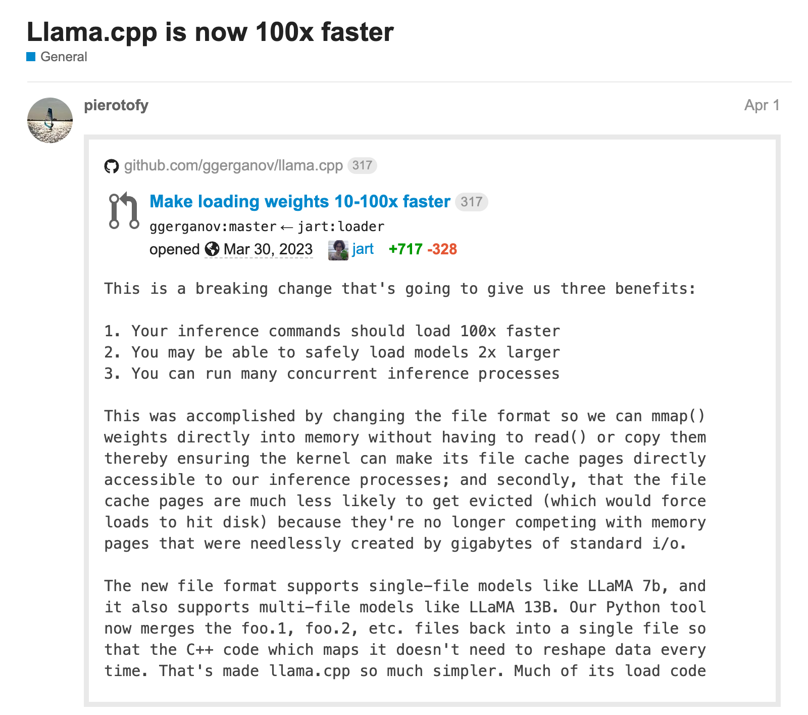
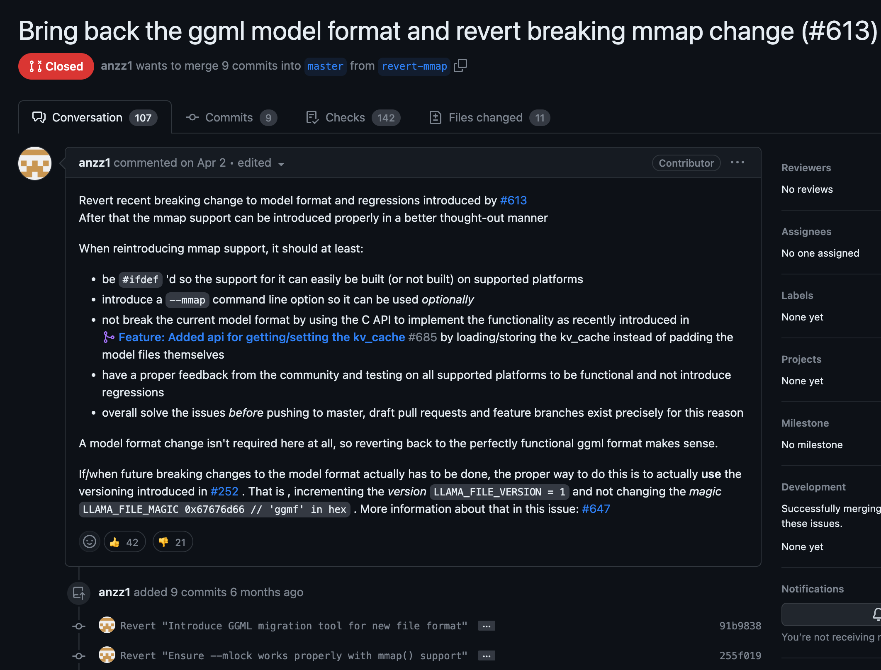
Example: llama.cpp load

Slide 75
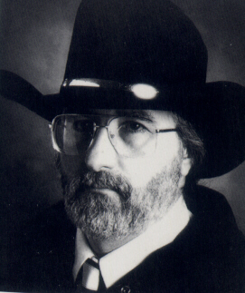
Worse Is Better
Richard P. Gabriel
https://www.dreamsongs.com/RiseOfWorseIsBetter.html

Slide 76
Worse is Better
How to handle interrupt during a system-call
Must save user states: just a single PC is not enough
There are still states in the kernel, e.g., I/O buffers
Two choices: back out or press forward?
User Program
Kernel
PUSH %ebx
PUSH %ecx
Syscall
CMP %eax
JCC
XOR %eax
IN %eax
ST %eax BUF
JCC
IRET
PC = PC+4
Interrupt

Slide 77
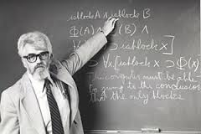
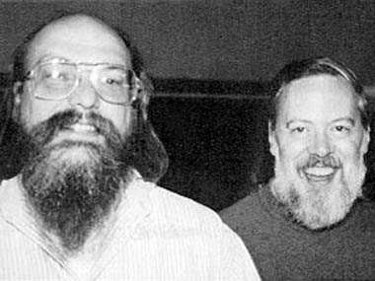
MIT Guys VS. New Jersey Guys (Bell Lab)

Slide 78
MIT Guys: We Do the Right Thing!
Back out and restore the user program PC
Re-execute the system call after resume
Rollback all the kernel states, e.g., the buffer
User Program
Kernel
PUSH %ebx
PUSH %ecx
Syscall
CMP %eax
JCC
XOR %eax
IN %eax
ST %eax BUF
JCC
IRET
Rollback kernel state
Restore user’s PC
Interrupt

Slide 79
New Jersey Guys: We Do the Simple Thing!
Sys-calls always finish, but sometimes return an error
The user needs to check the error code and retry in case
Because the right thing is too complex, and happens rarely
User Program
Kernel
PUSH %ebx
PUSH %ecx
Syscall
CMP %eax
JCC
XOR %eax
IN %eax
ST %eax BUF
JCC
IRET
User needs to check retval
and re-execute if necessary
Interrupt
Just return to user!

Slide 80
Simplicity VS. The Right Thing
 |  | MIT Guys | New Jersey Guys
Simplicity : |  | Simple implementation is more important than simple interface | Simple implementation is more important than simple interface
Correctness : |  | Incorrectness is not allowed | It’s better to be simple than correct
Consistency : |  | Inconsistency is not allowed | It can be sacrificed for simplicity
Completeness : |  | Must cover as many as possible | It can be sacrificed for simplicity
MIT : |  | Correctness = Consistency > Completeness > Simplicity
New Jersey : |  | Simplicity > Anything else

Slide 81
Case Study: Map-Reduce
MapReduce: Simplified Data Processing on Large Clusters, OSDI’04

Slide 82
What Did People Do Before MapReduce?
A user wants to analyze big data (in TB)
He will think about distributing the task to 1000 machines
Split the data to 1,000 pieces for each machine
Send the data and code to 1,000 machines
Control the 1,000 machines to run
Collect the 1,000 outputs
Calculate the 1,000 outputs to get the final result
Now, consider following scenarios:
Machine failures
Machine number scales to 10,000 (even more failures…)

Slide 83
MapReduce Provides:
Automatic parallelization and distribution
Fault-tolerance
I/O scheduling
Status and monitoring
And a simple interface to use: map() / reduce()

Slide 84
Programming Model
map (in_key, in_value) -> list(out_key, intermediate_value)
Processes input key/value pair
Produces set of intermediate pairs
reduce (out_key, list(intermediate_value)) -> list(out_value)
Combines all intermediate values for a particular key
Produces a set of merged output values (usually just one)
Inspired by similar primitives in LISP and other languages

Slide 85
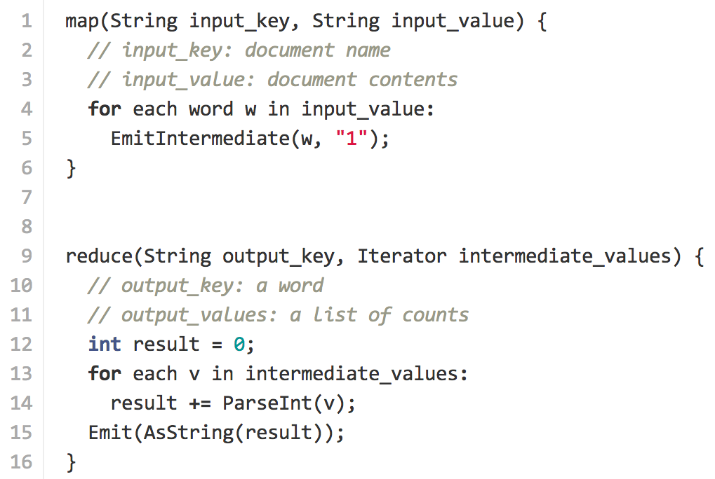
Example: Count Word Occurrences

Slide 86
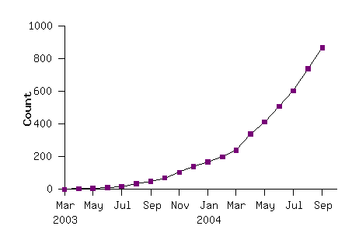
Model is Widely Applicable
Example uses: Distributed grep, distributed sort, web link-graph reversal, term-vector per host, web access log states, inverted index construction, document clustering, machine learning, statistical machine translation, …
Number of MapReduce Programs
Running in Google

Slide 87
Implementation Overview
Thousands of PC: 2-CPU, 2-4 GB memory
Limited bisection bandwidth
Storage is on local IDE disk (cheap, but likely to fail)
GFS: distributed FS managers data (SOSP’03)
Job scheduling system
Implemented as a C++ library, linked to user’s apps

Slide 88
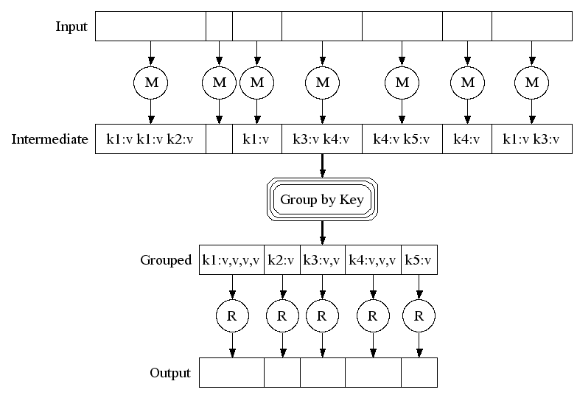
Execution

Slide 89
Architecture
Master node
Worker node

Slide 90
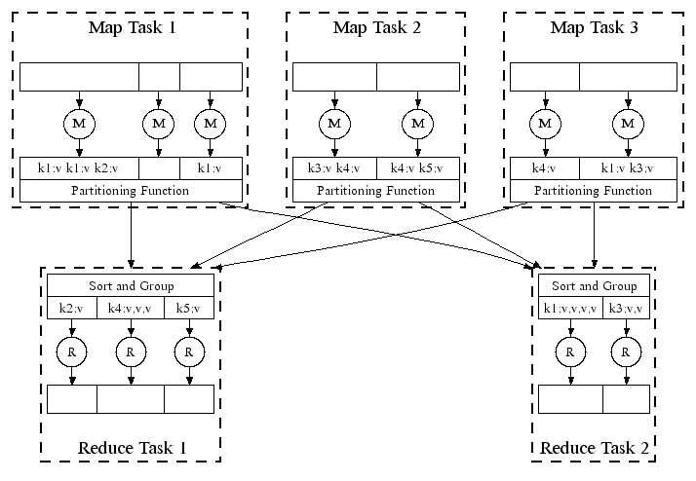
Parallel Execution

Slide 91

Task Granularity and Pipelining
Fine granularity tasks: many more map tasks than machines
Minimizes time for fault recovery
Can pipeline shuffling with map execution
Better dynamic load balancing

Slide 92
Fault Tolerance: Handled via Re-execution
On worker failure:
Detect failure via periodic heartbeats
Re-execute completed and in-progress map tasks
Re-execute in progress reduce tasks
Task completion committed through master
Master failure:
Could handle, but not yet (master failure unlikely)
Robust: lost 1,600 of 1,800 machines once, but finished fine

Slide 93
Refinement: Redundant Execution
Slow workers significantly lengthen completion time
Other jobs consuming resources on machine
E.g., bad disks with soft errors transfer data very slowly
E.g., weird things: processor caches disabled (!!)
Solution: Near end of phase, spawn backup copies of tasks
Whichever one finishes first "wins"
Effect: Dramatically shortens job completion time

Slide 94
Refinement: Locality Optimization
Master scheduling policy:
Asks GFS for locations of replicas of input file blocks
Map tasks typically split into 64MB (== GFS block size)
Map tasks scheduled so GFS input block replica are on same machine or same rack
Effect: 1,000s of machines read input at local disk speed
Without this, rack switches limit read rate

Slide 95
Refinement: Skipping Bad Records
Map/Reduce functions sometimes fail for particular inputs
Best solution is to debug & fix, but not always possible
On segmentation fault:
Send UDP packet to master from signal handler
Include sequence number of record being processed
If master sees two failures for same record:
Next worker is told to skip the record
Effect: Can work around bugs in third-party libraries

Slide 96
Other Refinements (see paper)
Sorting guarantees within each reduce partition
Compression of intermediate data
Combiner: useful for saving network bandwidth
Local execution for debugging/testing
User-defined counters

Slide 97
Conclusions
MapReduce has proven to be a useful abstraction
Greatly simplifies large-scale computations at Google
Fun to use:
Focus on problem, let library deal with messy details

Slide 98
Principles in MapReduce
Principle of least astonishment
The user only needs to define map/reduce functions
Optimize for the common case
List the most common scenarios, not all of them
Robustness principle

Slide 99


Criticism: “MapReduce: A Major Step Backwards”
Prof. David DeWitt
Wisconsin University
Michael Stonebraker
CTO of Informix
Professor in MIT
Professor in UC Berkeley
Notes:
http://blog.csdn.net/nevasun/article/details/7590882

Slide 100
Criticism: “MapReduce: A Major Step Backwards”
A giant step backward in the programming paradigm for large-scale data intensive applications
A sub-optimal implementation, in that it uses brute force instead of indexing
Not novel at all — it represents a specific implementation of well known techniques developed nearly 25 years ago
Missing most of the features that are routinely included in current DBMS
Incompatible with all of the tools DBMS users have come to depend on
Well, these are all “the right things”, but…

Slide 101

After MapReduce
Hadoop
An open-source implementation of MapReduce
Again, very bad performance at first
But widely used!
Cassandra, Hbase, Hive, PIG, Spark, ZooKeeper, …
Keep being optimized by both academy and industry
Till today

Slide 102

After MapReduce: Google
MapReduce retired around 2007
2010: Pregel ^{[SIGMOD’10]} for graphic computing
2012: Spanner ^{[OSDI’12]}
Global distributed database using TrueTime API
2014: DataFlow
Map-Reduce is retired in Google

Slide 103

Another Principle
Design for Iteration
It’s hard, if possible, to do things right in the 1st time
Notes:
体现了 design 4 iterations
问题：工具链不兼容

Slide 104
P.r.o.s.e.c.
The way to read a paper and take note

Slide 105
P.R.O.S.E.C.
Problem
Related work
Observation
Solution
Evaluation
Comments

Slide 106
P.R.O.S.E.C.
Problem: What is the motivation? Why important?
Related work: Why other work didn’t solve it?
Observation: What is the key insight? Make it simple
Solution: How does this work solve the problem?
Evaluation: Does this work really solve the problem?
Comments: What could be better? Your own opinion

Slide 107
What makes a novel solution?
This is my own opinion
At least, the solution is not revealed in the literature
Is the solution hard?
Is the solution requiring much efforts?
Etc.

Slide 108
Course Info
Instructors
Yubin Xia: xiayubin@sjtu.edu.cn
Xingda Wei: wxdwfc@sjtu.edu.cn
Website
https://oc.sjtu.edu.cn/

